Slide 1

Inferring Phylogenies: BEAST2 and the Protracted Birth-Death model
By Femke Thon & Jolien Gay
Supervisors: Richel Bilderbeek & Rampal Etienne
Notes:
NOTE: Some photo’s are placeholders

Slide 2
Research Question
“Does including protractedness in speciation models give rise to more accurate and realistic phylogenies? ”

Slide 3
Introduction: What?
Diversification
Evolutionary process
Population -> distinct species (reproductive isolation)
Temporal pattern ??
Phylogenies
Speciation models

Slide 4
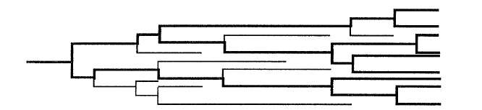
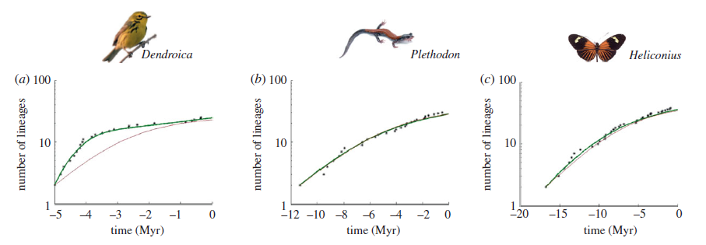
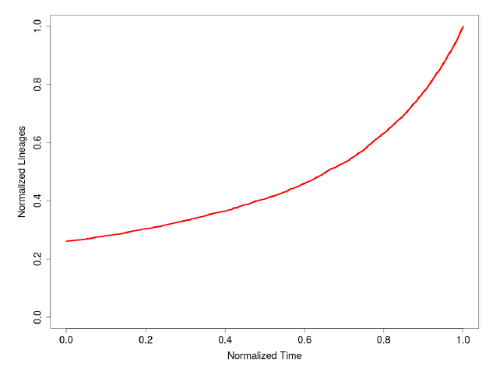
Introduction: What?
Pure Birth-Death model (BD)
Constant speciation and extinction rates
Instant speciation
Number of lineages increase (pull of the present)
BUT: slowdown observed towards the present
Nee Et Al (1994)
vs.
Etienne Et Al (2011)

Slide 5
Introduction: What?
Possible explanations:
Simple artefact
Diversity dependence

Slide 6
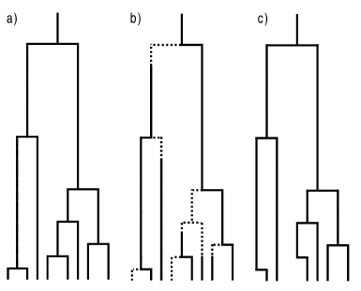
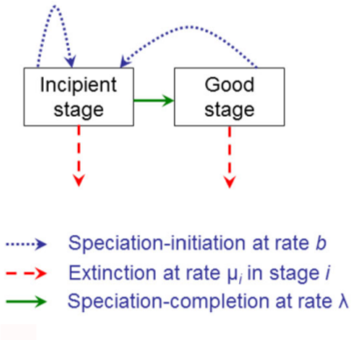
Introduction: What?
Protracted Birth-Death model (PBD)
Extension of BD
Assumes speciation takes time
Assumes two states
PB | PBD | phylogeny
Etienne and Rosindell (2012)

Slide 7


Material
BEAST2
Package-structure (R)
GitHub

Slide 8
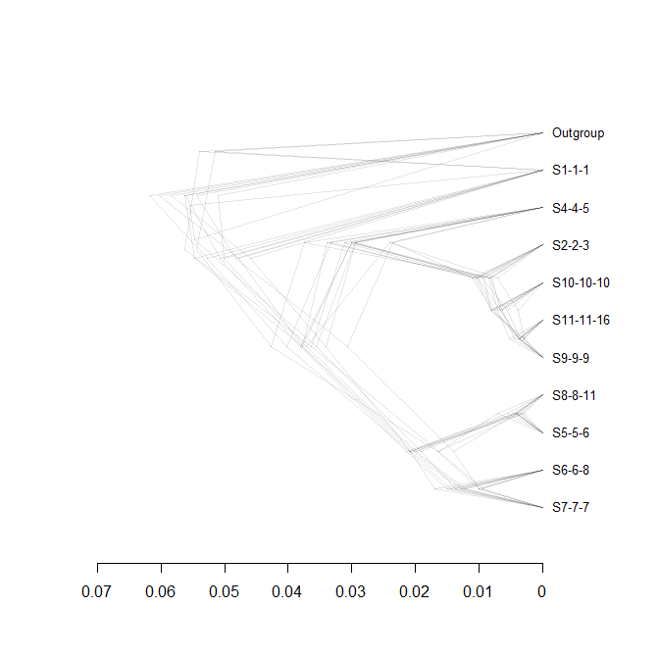
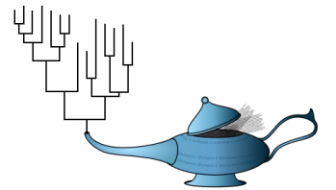
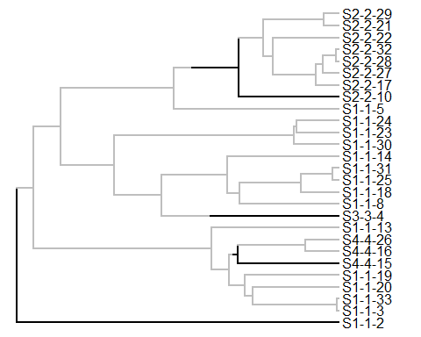


Methods
Overview
5 steps
‘true’ tree
posterior

Slide 9
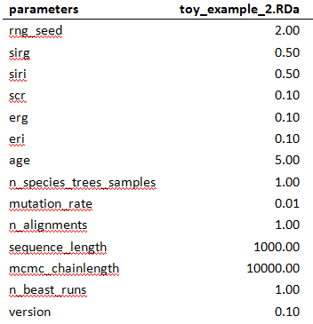
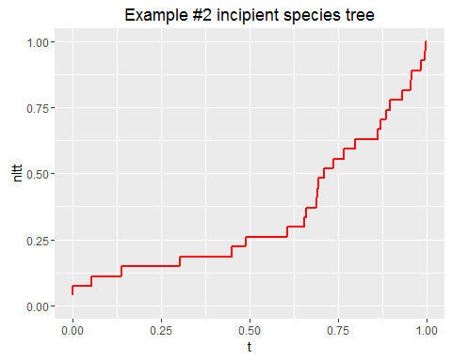
1. Start with ‘true’ species trees
Create parameter files
Simulate incipient tree / parameter file (2x)

Slide 10
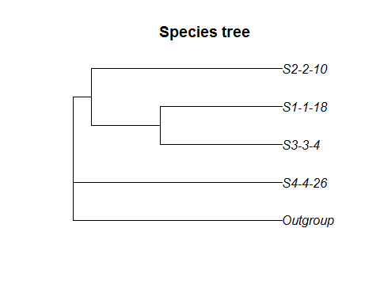
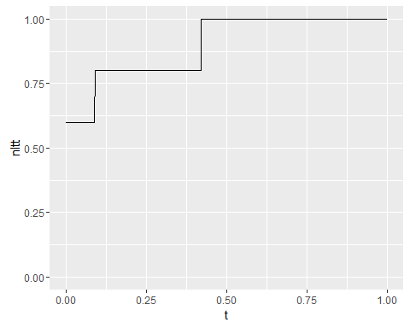
2. Sample a (monophyletic) species trees
Sample unique species from incipient tree (2x)
Add outgroup
Notes:
Outgroup may be unnecessary. Constant clock rate used.

Slide 11
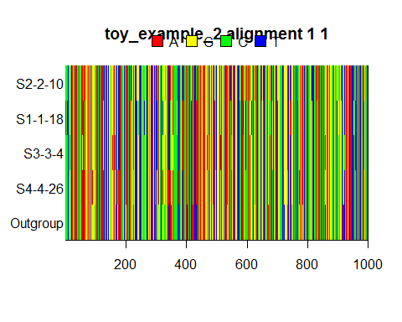
3. Convert to DNA alignment
Input BEAST2
Simulate alignment from species tree (2x)

Slide 12
4. Infer a posterior (BEAST2)
Output BEAST2
Posterior / alignment (2x)

Slide 13
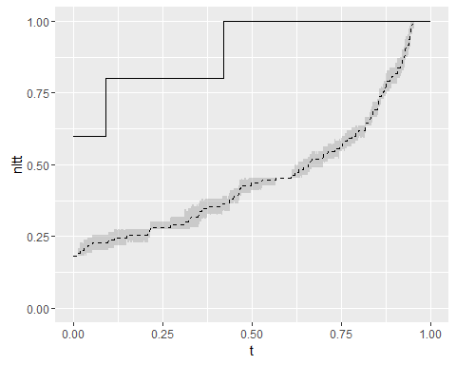
5. Analysis
Compare posterior with sampled true species tree (from step2)
Summary statistics to quanitfy error (gamma, ....)

Slide 14
Main Question
Should protractedness be included in speciation models?
Sub questions
Can BEAST2 accurately recover a ‘true’ tree?
Error big enough?
Right summary statistics used?

Slide 15
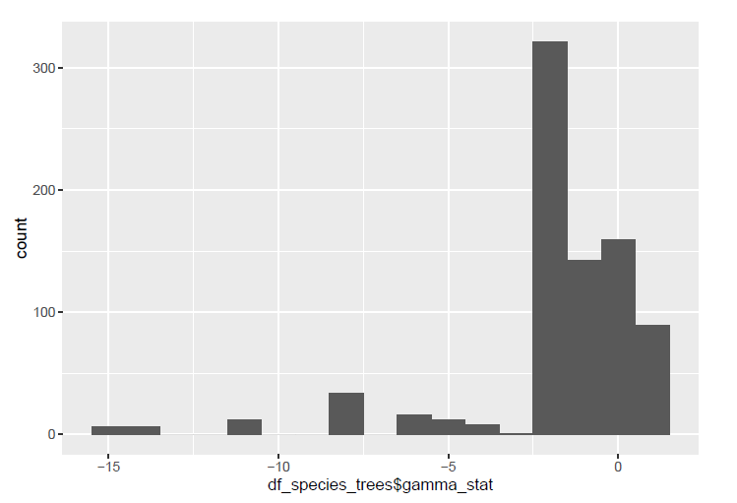
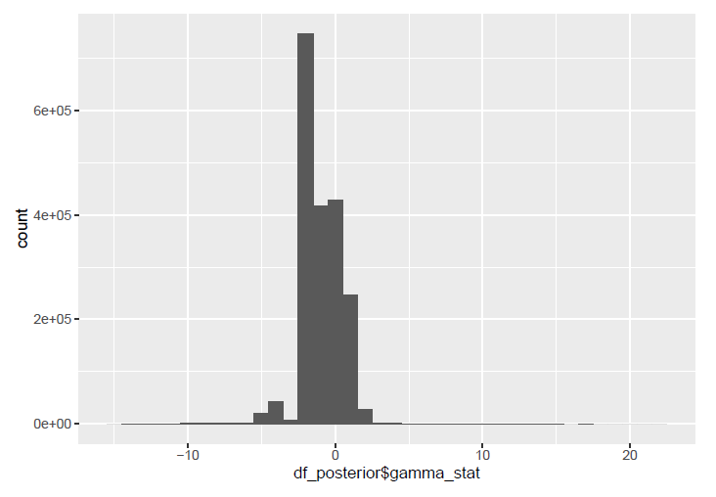
Results
Distribution of gamma statistics

Slide 16
Results
Distribution of ...

Slide 17
Discussion & Conclusions
Error gamma statistics: substantial
Correct gamma statistics used?
Error ....: ??

Slide 18
Questions?
Notes:
POSSIBLE QUESTIONS?:
Q1: Why did you use an outgroup?
Q2: Are the used summary statistics the best, and why?

Slide 19

BEAST2
Bayesian statistics
MCMC
Multiple speciation models can be applied
All assume instant speciation
Posterior
Prior
Likelihood
Marginal probability

Slide 20
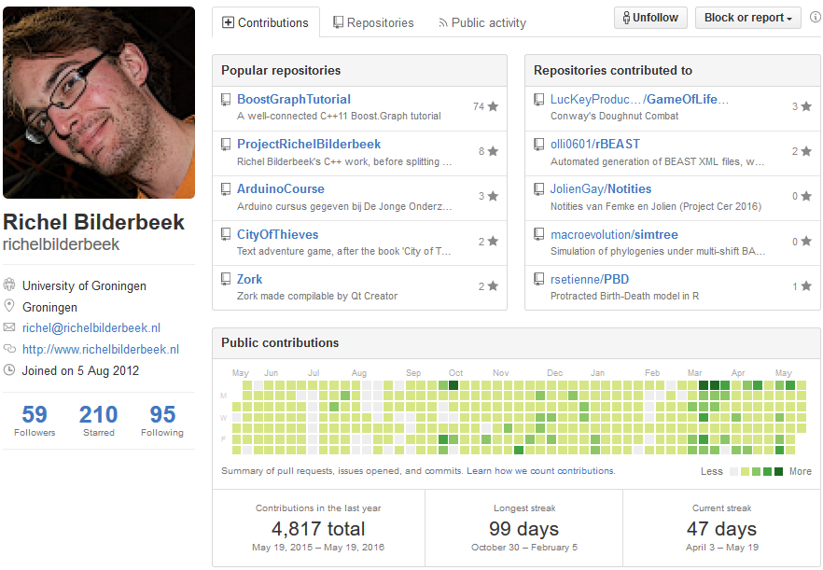
GitHub

